Slide 1
Finding the formula for Popularity
Popularity prediction using mashable articles from 2011-2012

Slide 2
Early success - Growth - 52/1
Mashable reached 2 million readers in its first 18 months.
Today Mashable has over 25 million visitors.
Part of its success is because Mashable has gone beyond the 80/20 rule to reach the 52/1 rule, where 1% of its posts drives 52% of the traffic. In this scenario, know what is the recipe of the 1% is critical to Mashable’s business objectives.

Slide 3
Data
It has 61 variables
It has about 40,000 articles published in 2013-2014
Variables:
Day of the week
Number of words in the title
Number of words in the content
Links
Videos
Photos

Slide 4
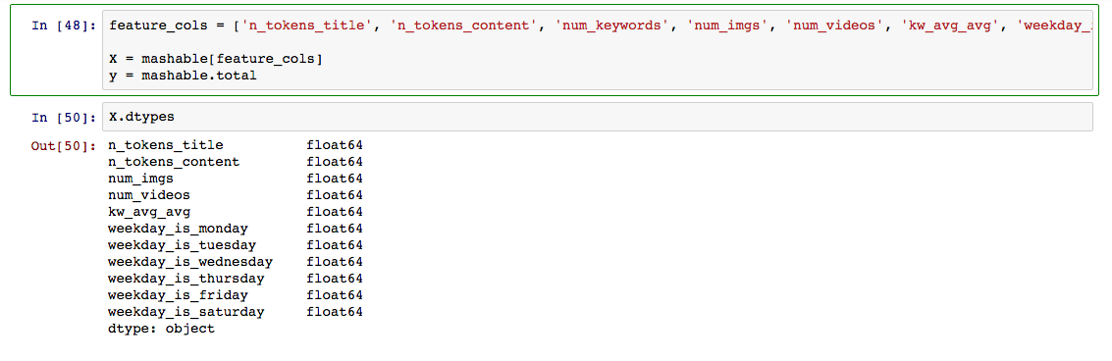
Variables

Slide 5
Classification Problem
Total = Dummy variable
>= 10.000 shares ==1, otherwise 0
Only 2108 articles were really popular

Slide 6
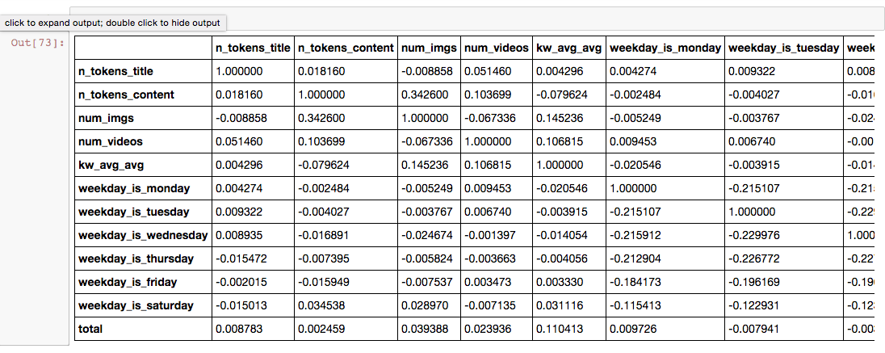

Slide 7
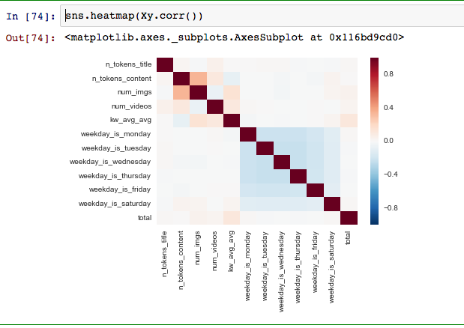

Slide 8
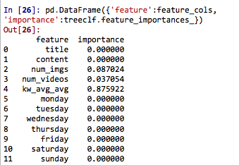

Slide 9
Logistic regression
Accuracy score:
0.94
Sensitivity: 0.008
Specificity: 0.99
AUC:0.67

Slide 10
Next Steps
Get the true values
kNN
Create new variables
Random Forest

